Slide 1
Executive presentation
Lucía Quintana

Slide 2
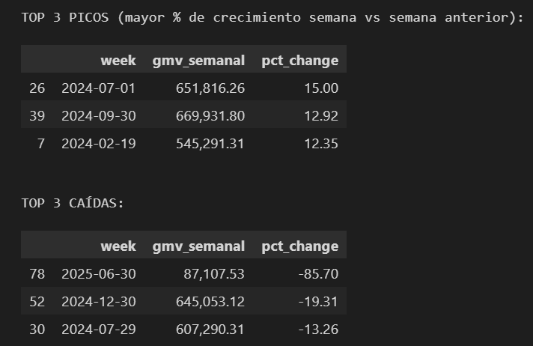
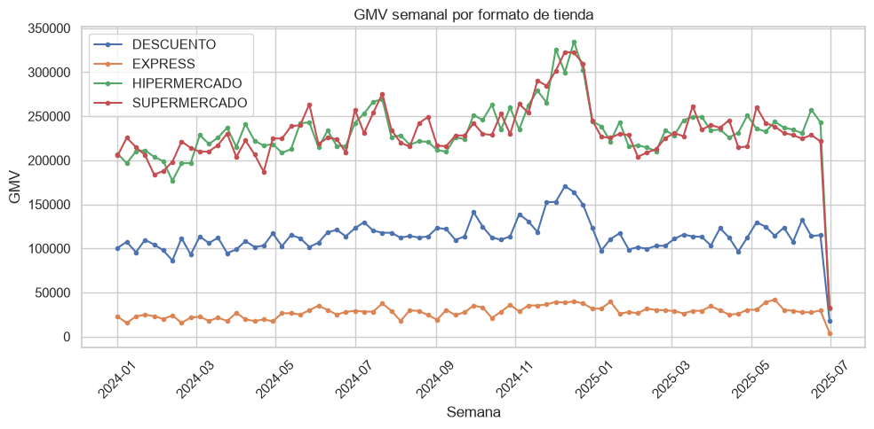
Executive Summary
GMV by week by store’s format
GMV Peaks and Troughs by Week
- Format most sensitive to seasonality: EXPRESS
- Peak: July 1, 2024 → Hypothesis: End of month, start of holidays.
- Trough: June 30, 2025 → Hypothesis: Month-end in the middle of the year, with lower liquidity.
Store Productivity :
10 stores (25% of the network) are BAJO_RENDIMIENTO: generating GMV/m² below the bottom 25% of their format

Slide 3



Store Performance
Where We're Winning and Losing
Accumulated GMV %
Best-performing format
Hipermercado
TOP
EX: Hogar
76.03%
Weakest format
Express
HM: Hogar
75.92%
SM: Hogar
75.90%
Format:
HM: Hipermercado
EX: Express
SM: Supermercado
Best-performing category
Home
Weakest category
Electrónica
EX: Electrónica
52%
BUTTOM
Notes:
1- (Source: Query 1 — aggregate comp_sales_growth_pct by format)
2- (Source: Query 2 — count of flag_rendimiento = 'BAJO_RENDIMIENTO')
3- (Source: Query 5 — SUM(gmv_estimado_perdido))

Slide 4
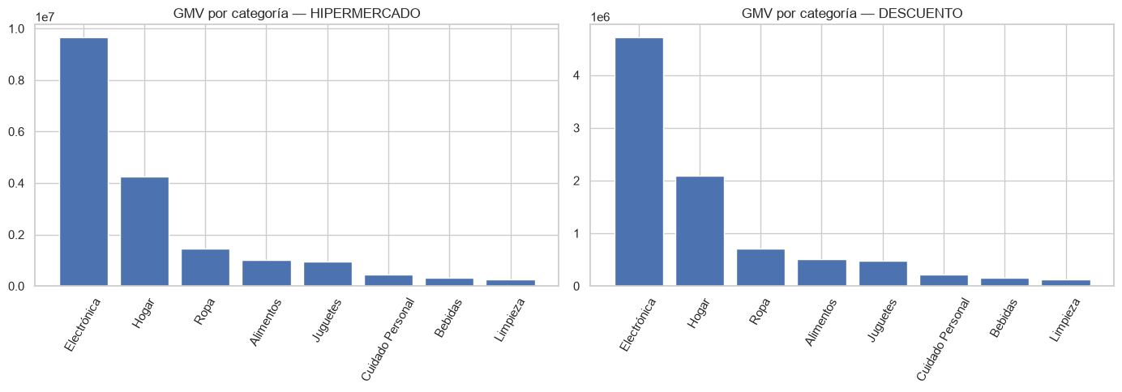
Oportunnities
Where We Can Improve
10 stores (25% of the network) are BAJO_RENDIMIENTO
Low-margin vendors
4 stores are below the 25th percentile of GMV/m² in their format — mainly concentrated in Supermercado.
Underperforming stores
Categories that account for 80% of GMV (chain-wide): While not reaching 80%, the Home category in EXPRESS format accounts for 76.3% of GMV.
- Do they overlap between HYPERMARKET and DISCOUNT?: Yes.
- Business interpretation: DISCOUNT and HYPERMARKET are more indexed to Home (convenience or impulse purchases).

